Slide 1
FLEA MARKET
Web Project

Slide 2
Introduction
Web project
Our website focus on providing a platform about used stuff for students at Boston. This web is based on Bootstrap, angular 2, typescript and MongoDB.
We have a big vision to make students get more effective information on our platform when they move in and out. And we can save them lots of time and money cost. We are dedicated to make high effective utilization of second-hand resources.

Slide 3
Project Goal
Web project
Because there are many students in Boston move in and out at same time, so they have lots of used stuff waiting to be sold or exchange. At the same time, there is no suitable platform for that. That’s why they need a platform to make it more effective on our website.

Slide 4
Distribution of work
Web project
Yu: Login, hero-area
Sun: Cart,order
Xia: Search, footer, header
Tu: List, details

Slide 5
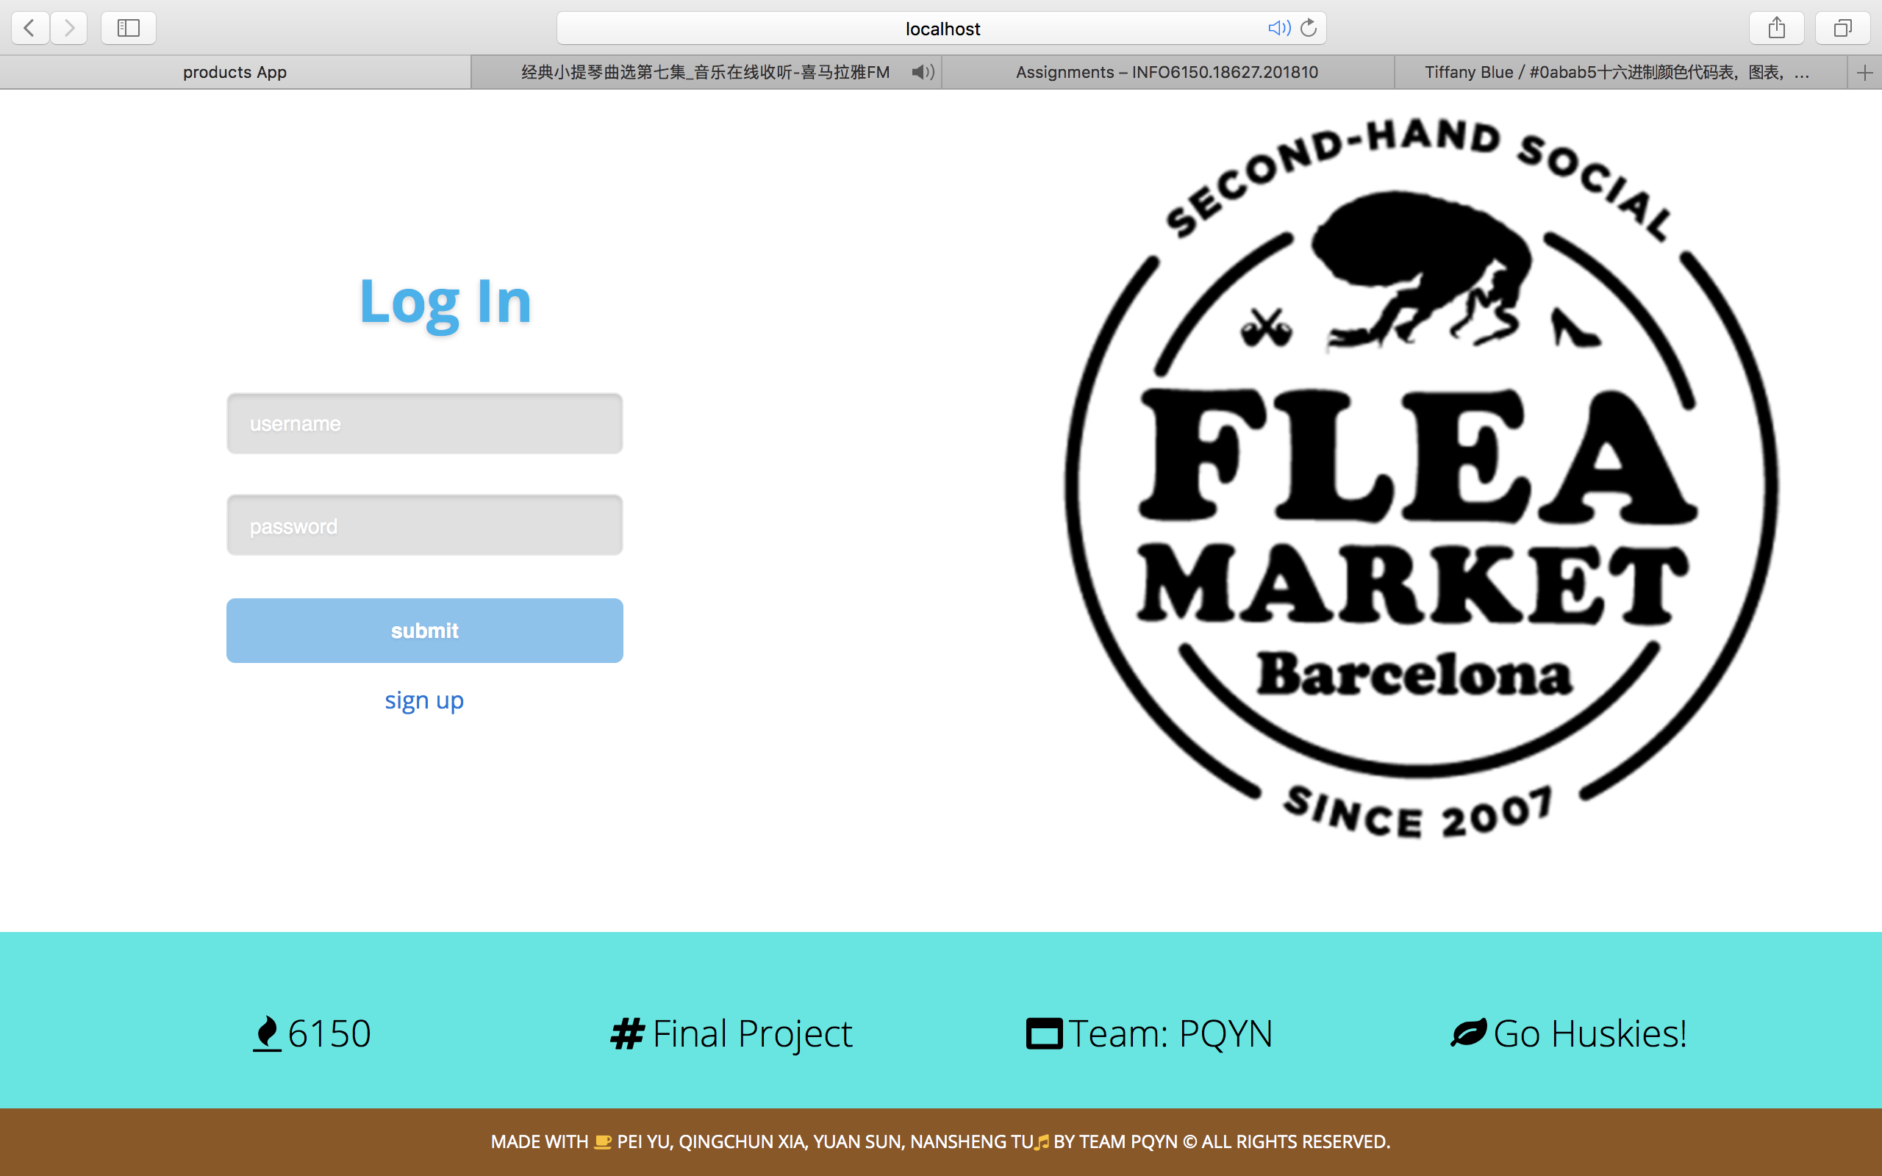
Screenshots
Web project

Slide 6
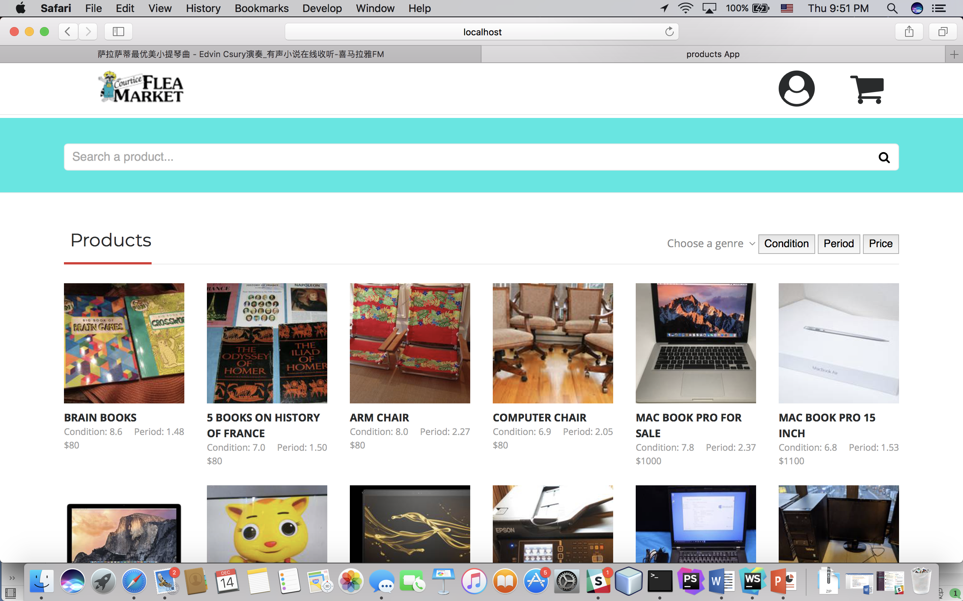
Screenshots
Web project

Slide 7
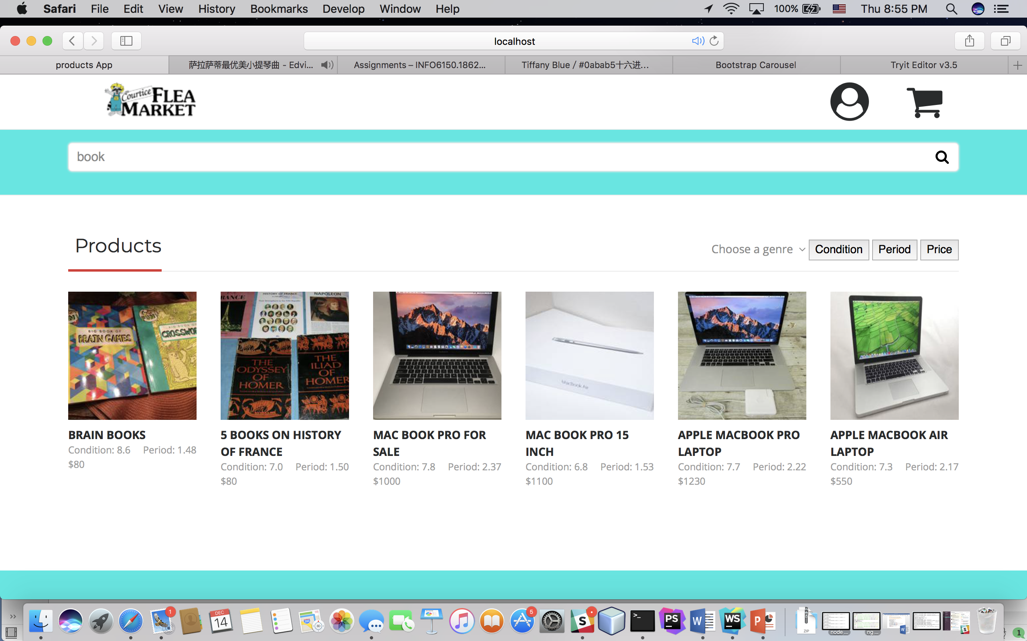
Screenshots
Web project

Slide 8
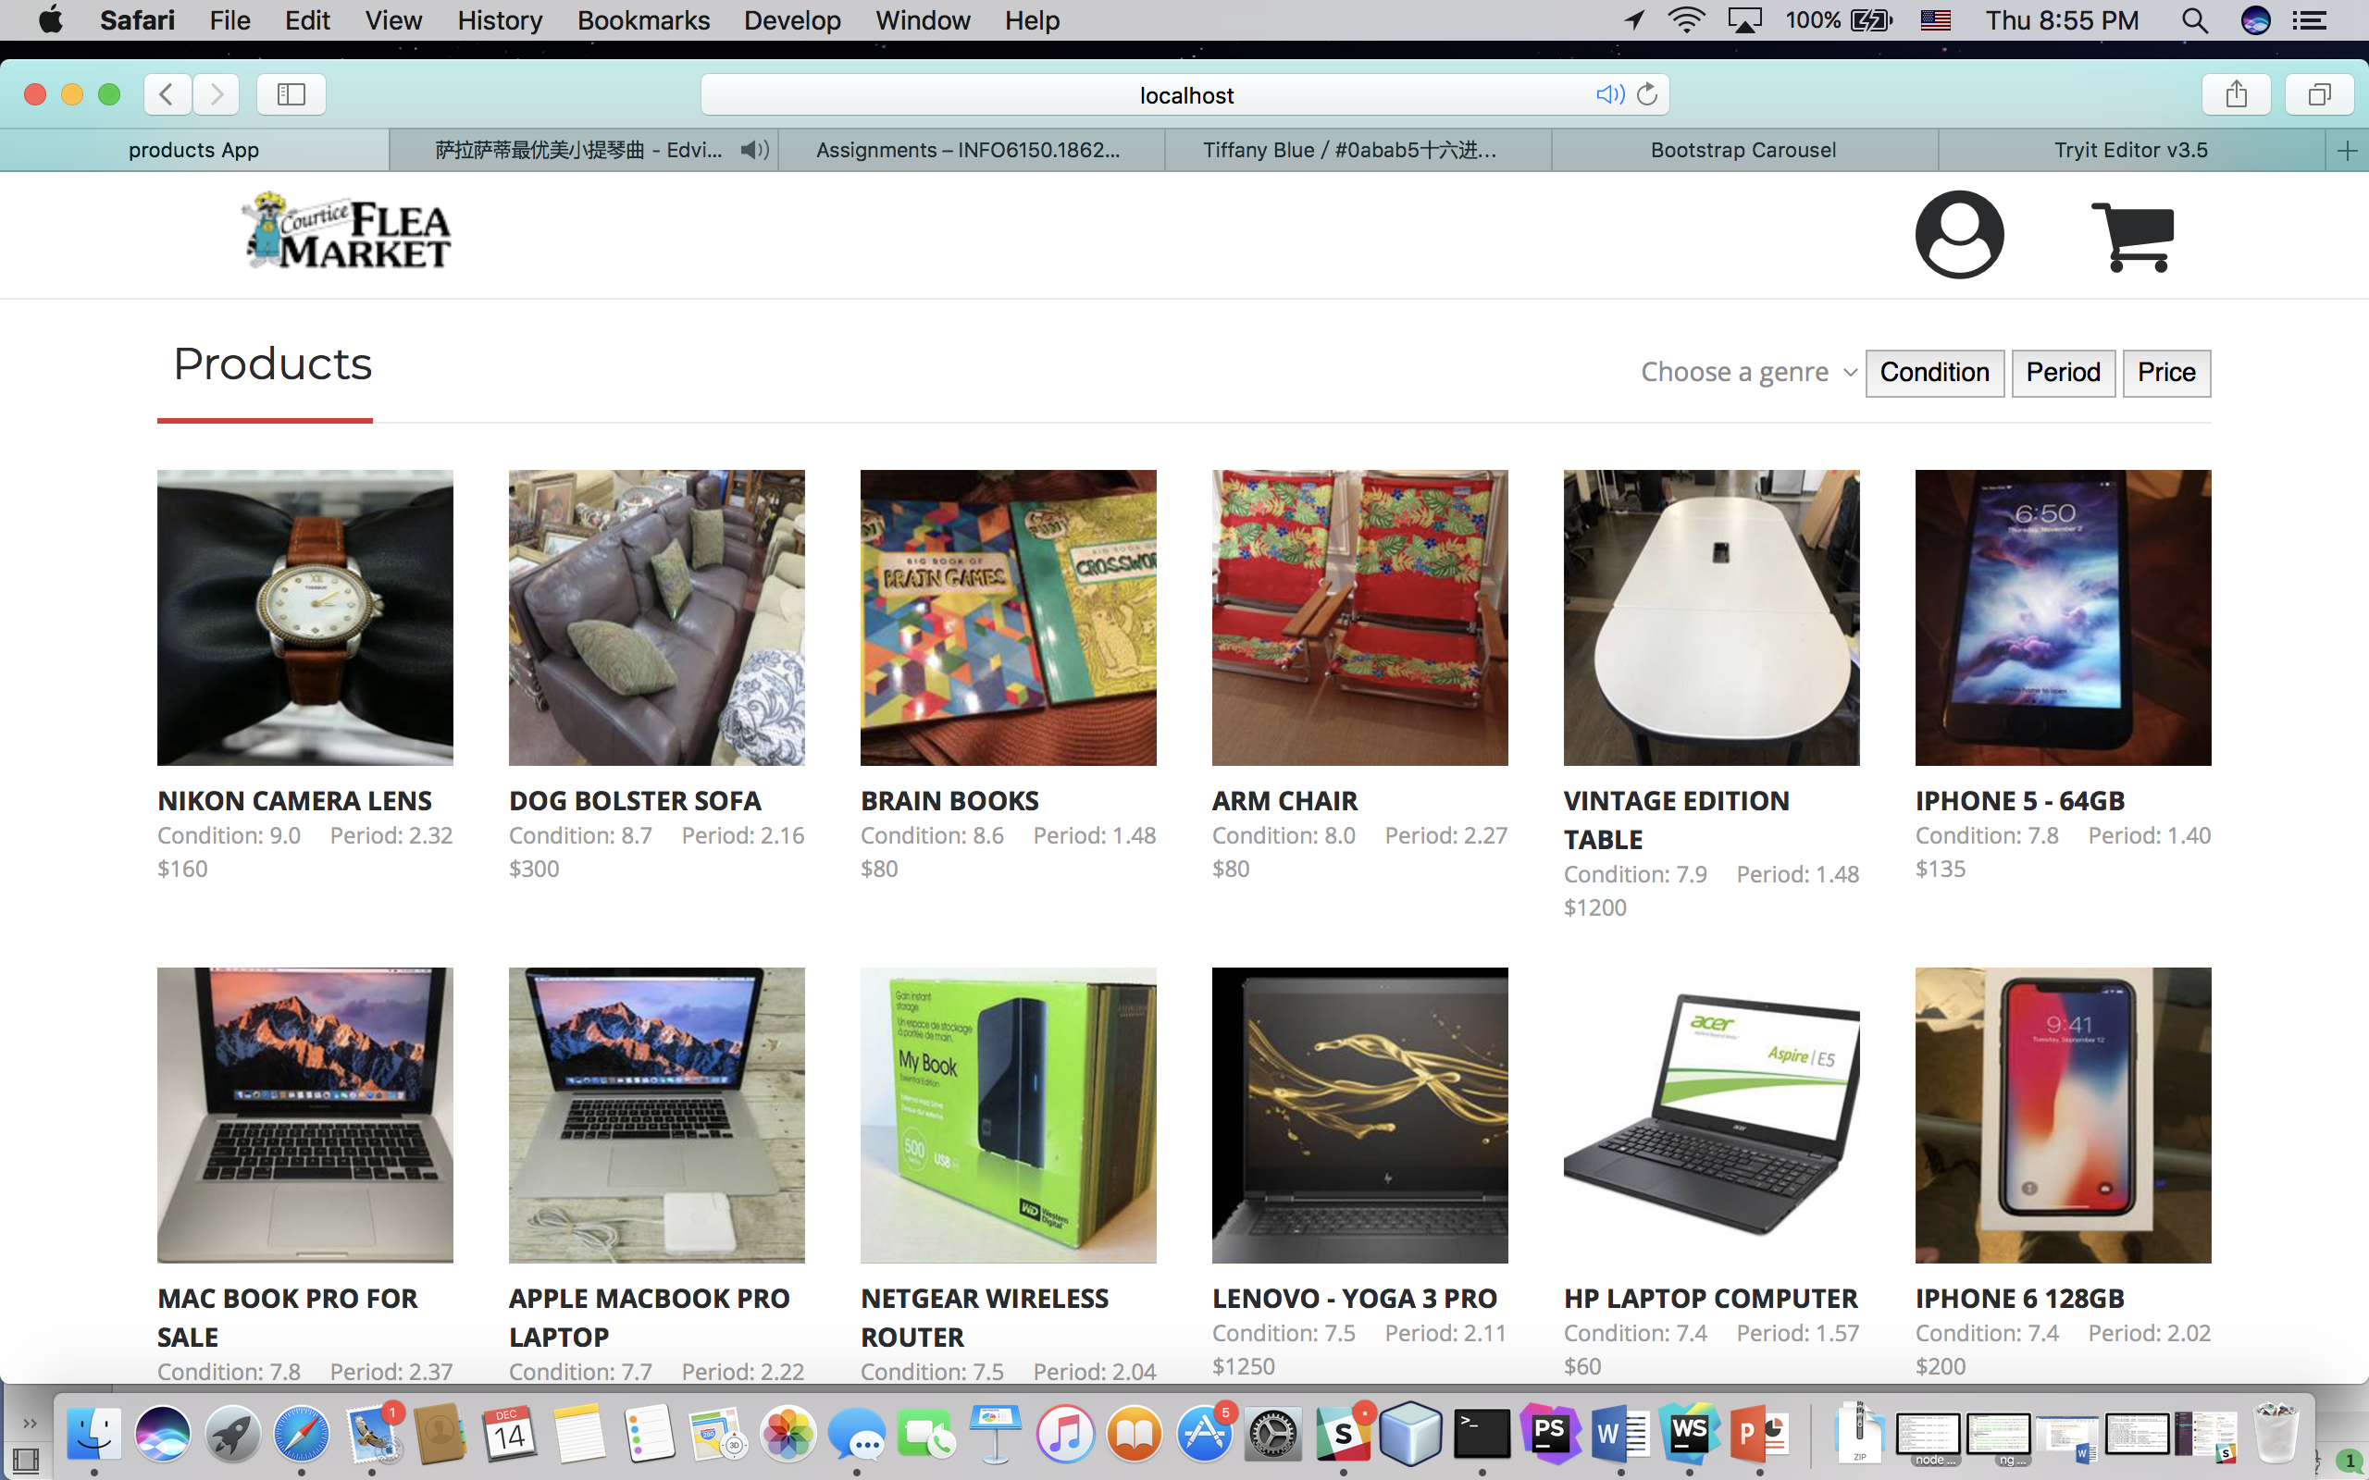
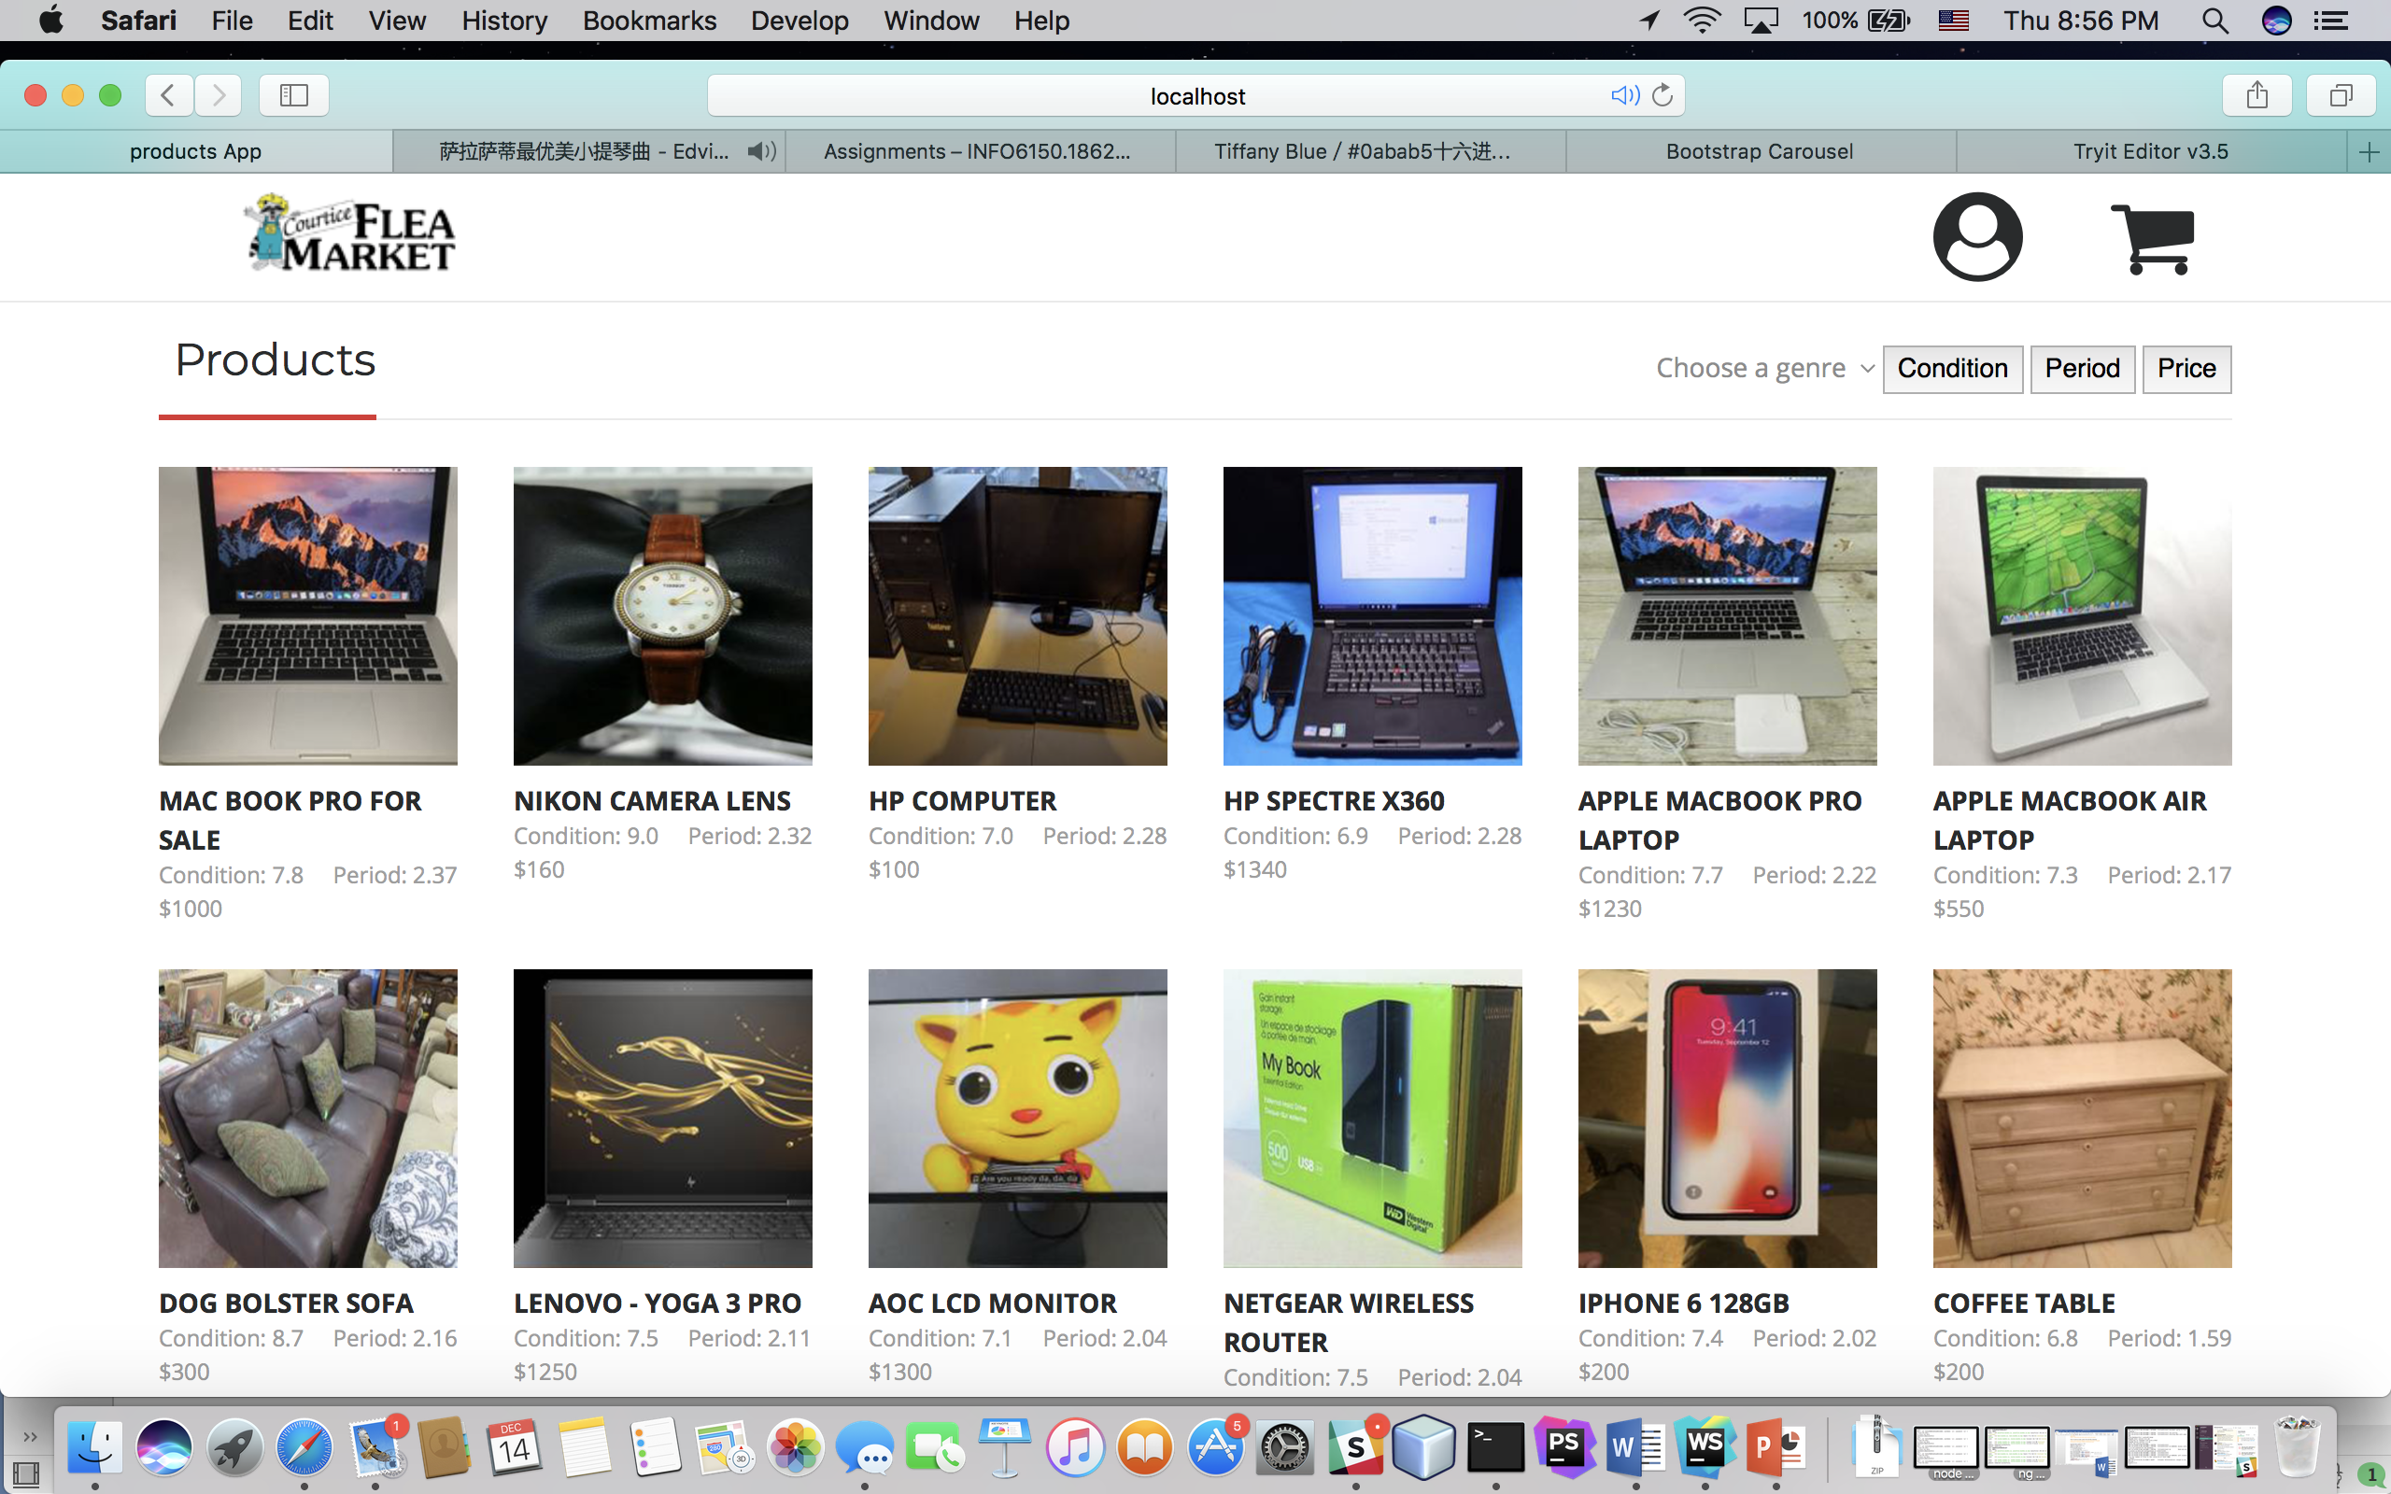
Screenshots
Web project

Slide 9
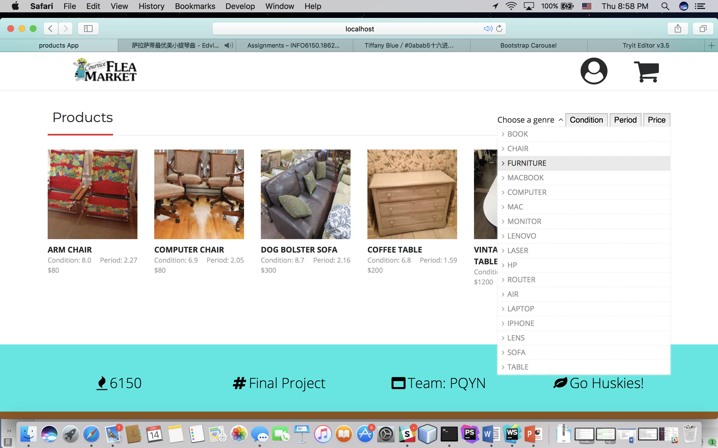
Screenshots
Web project

Slide 10
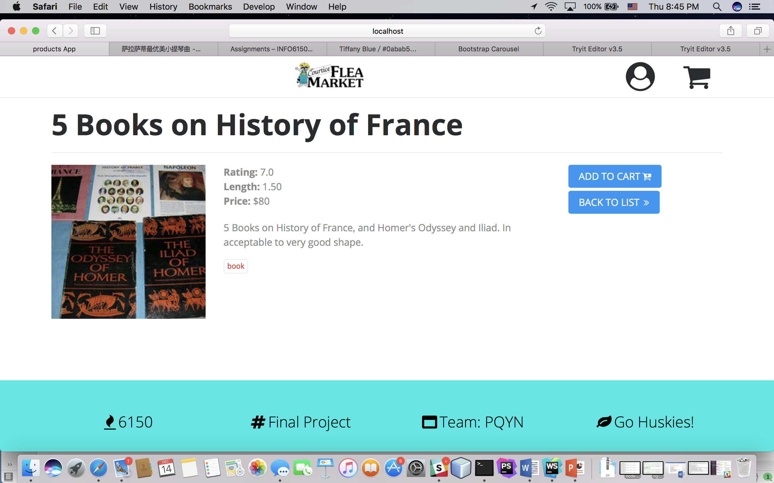
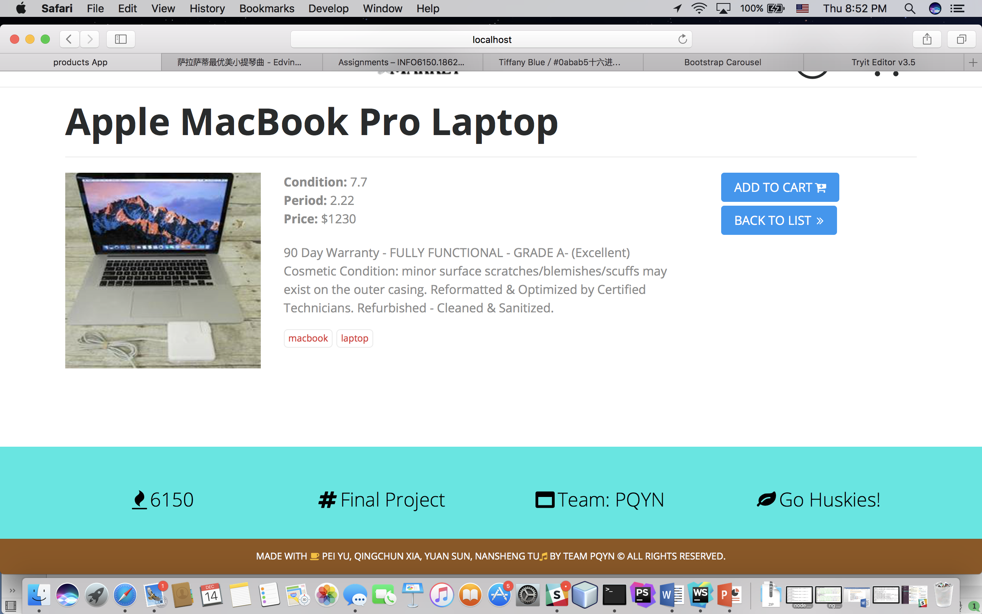
Screenshots
Web project

Slide 11
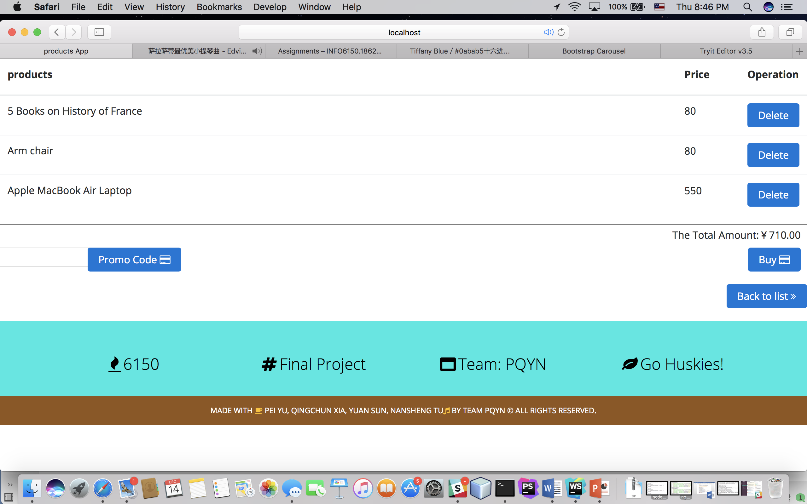

Screenshots
Web project

Slide 12
Web project
Thanks very much!

